Slide 1


Blue City
The Water Sustainable City of the Near Future
A summary of Blue City, a 2014 report published by the Blue Economy Initiative

Slide 2
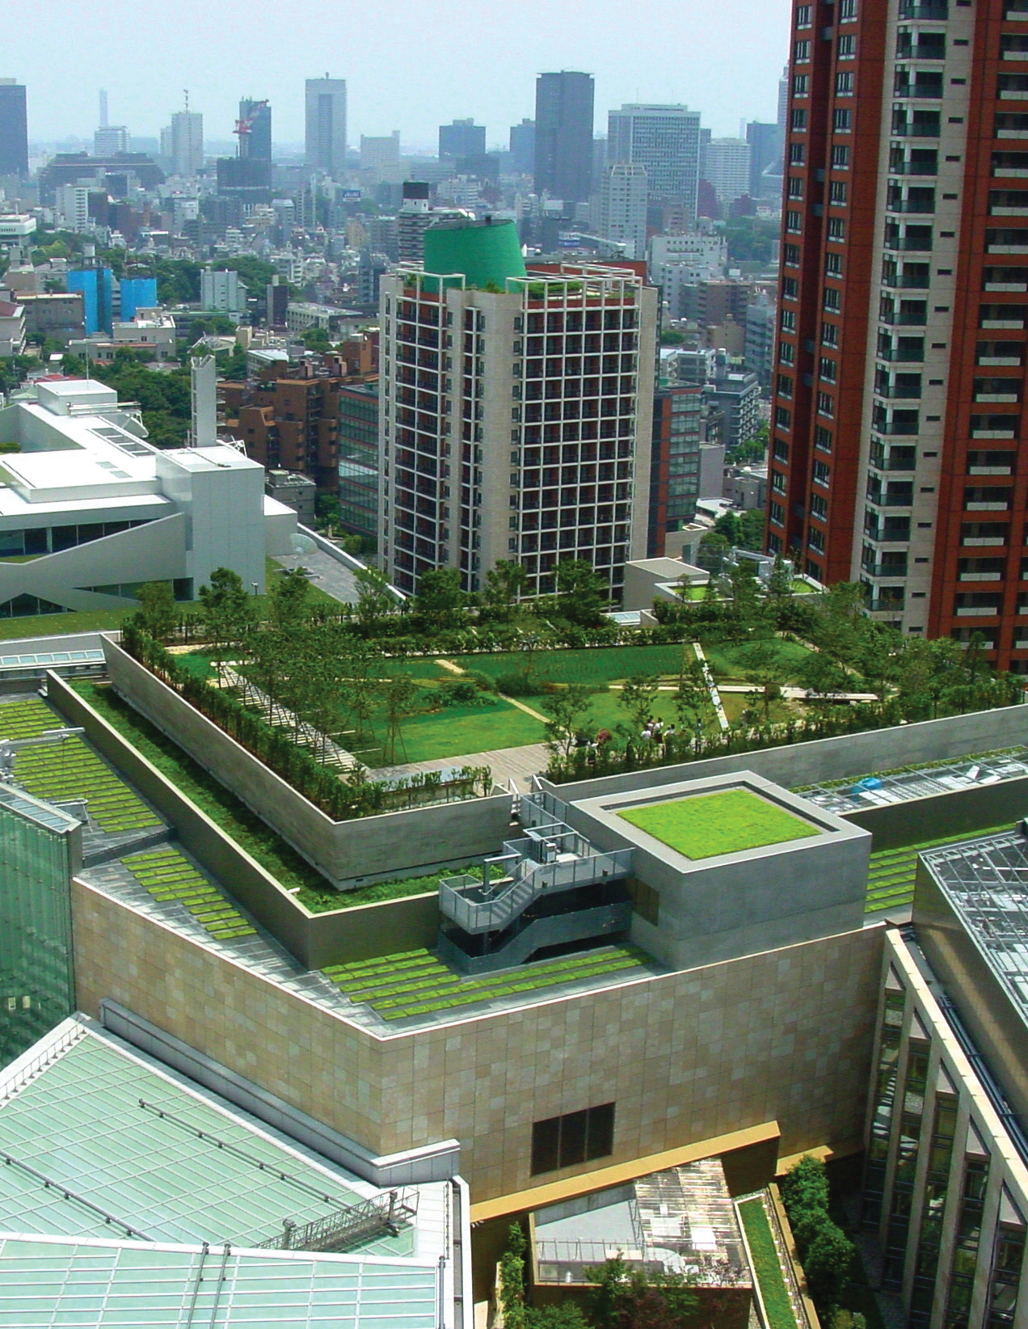
What would
a city look like
if water really mattered?
What makes
a “Blue City”?

Slide 3
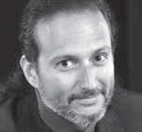
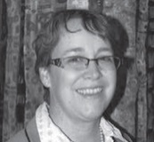


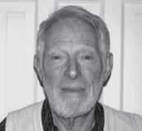


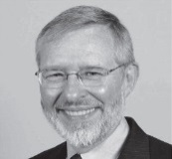
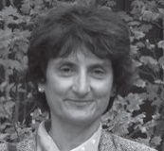
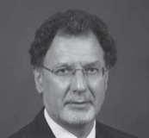

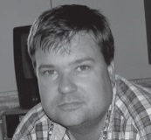

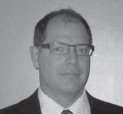

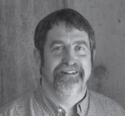
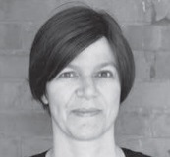
A VISION FROM THOUGHT LEADERS
To find out we asked 17 water-related professionals in Canada,
what their vision of a Water Sustainable City looks like.
Jean-François Barsoum
Senior Managing Consultant, IBM
Theresa McClenaghan
Executive Director & Counsel,
Canadian Environmental Law Assoc.
Lou Di Gironimo
General Manager, Toronto Water
Oliver M. Brandes
Co-Director & Sr. Research Officer, POLIS Project
Dr. David B. Brooks
Water Advisor, Independent
Kim Stephens
Executive Director, Partnership
for Water Sustainability in BC
David Henderson
Founder & Managing Director,
XPV Capital Corporation
Glen T. Daigger
Sr. Vice President &
Chief Technology Officer, CH2M HILL
Mary Ann Dickinson
President & CEO,
Alliance for Water Efficiency
Carl Bodimeade
Senior Vice President,
Hatch Mott MacDonald
Scott Murdoch
Principal & Landscape Architect,
Murdoch de Greef Inc.
Mike Hausser
Director of Asset Management,
City of Cambridge
Andrew Hellebust
President, Rivercourt Engineering
Greg P. Chartier
Asset Management Consultant, Independent
Carl D. Yates
General Manager, Halifax Water
Bryan W. Karney
Associate. Dean, Engineering,
University of Toronto; Principal,
HydraTek & Associates Inc.
Cate Soroczan
Senior Researcher, Canada Mortgage and Housing Corporation

Slide 4


IN A BLUE CITY,
WATER IS VISIBLE AND VALUED
A Blue City provides drinking water, wastewater, and stormwater services to residents and businesses. But that’s not all.
IN A BLUE CITY:
  Physical infrastructure
  is ‘green’
  Buildings
  accommodate
  natural
  processes
  People and
  businesses
  embrace
  ‘living with
  water’
  Impermeable
  surfaces are
  replaced with
  permeable ones
We can’t expect people to appreciate water unless they can actually see it and experience it. It aesthetically enriches the city, but it also keeps water in front of people so they understand and value it.”
– Glen T. Daigger,
Sr. Vice President & CTO, CH2M HILL

Slide 5




A BLUE CITY HAS A CULTURE
OF CONSERVATION
It puts all water sources to best use
Its land and water use decisions are connected
Its zoning bylaws encourage sustainable development
It relies on local water sources, such as stormwater
Notes:
5

Slide 6



A BLUE CITY HAS A CULTURE
OF CONSERVATION
It’s relatively compact – urban sprawl is discouraged
It minimizes resource and energy use as a part of its culture
It considers wind turbines for source protection and storage and uses water mains to generate additional energy capacity
Notes:
6

Slide 7
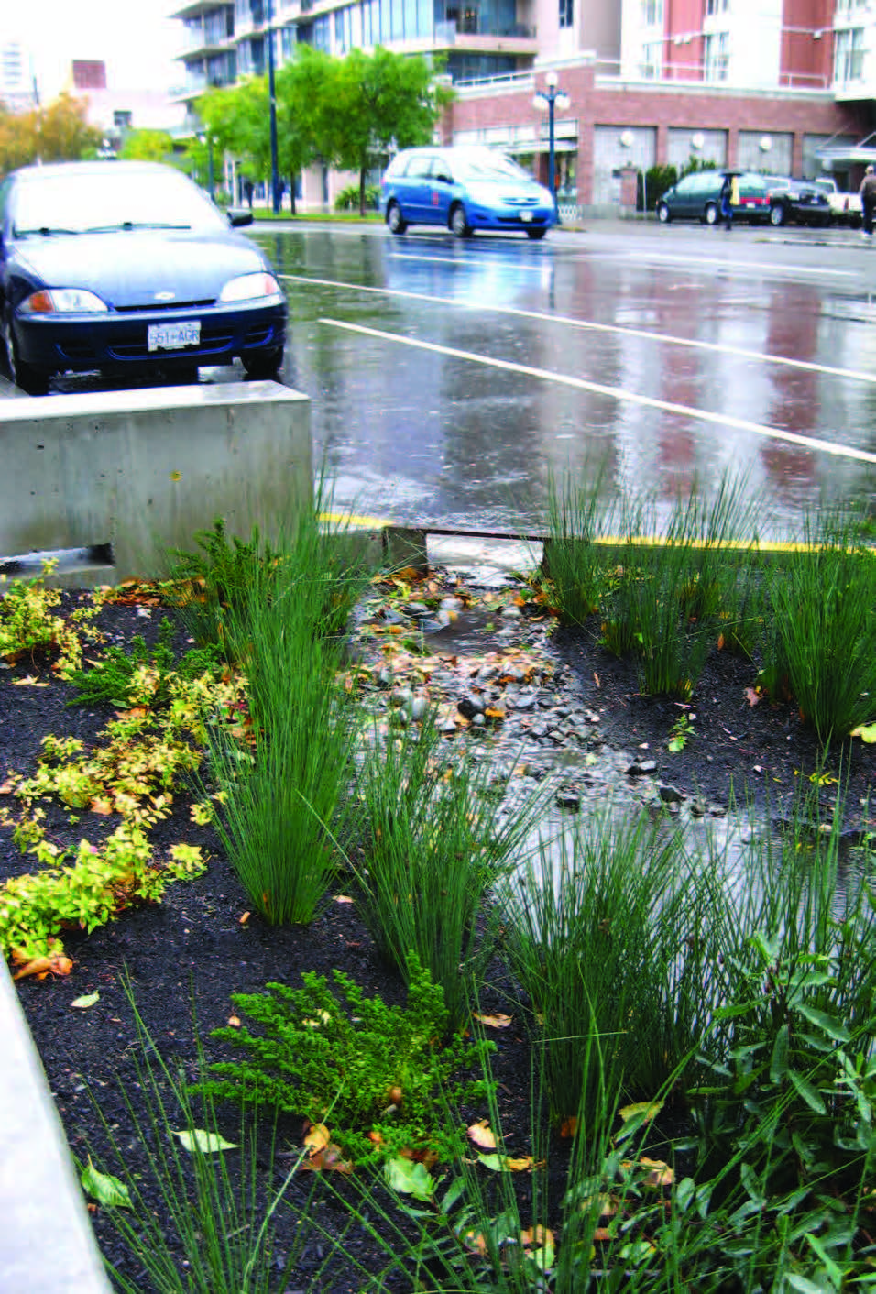
IN A BLUE CITY,
RESPONSIBILITY IS SHARED
  It has a long-term integrated community and asset management plan
  Its people work together across professions and departments for opportunities to connect with non-governmental institutions and other jurisdictions
  There’s a shared philosophy of managing people and their activities within their natural environment, instead of attempting to manipulate nature

Slide 8
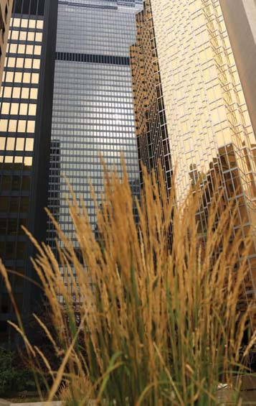
UTILITIES IN A BLUE CITY
  Focus on levels of service, develop
  asset management plans, and embrace life-cycle costing
  Develop new ways of financing capital investments that consider the long timeframe for returns and intergenerational equity
  Aim for full cost recovery and structure their rates to influence behaviours
Regulators should require utilities to have an asset management plan before they qualify for funding. Reward the well managed rather than bail the poorly managed.”
– Carl Bodimeade,
Sr. Vice President, Hatch Mott MacDonald

Slide 9
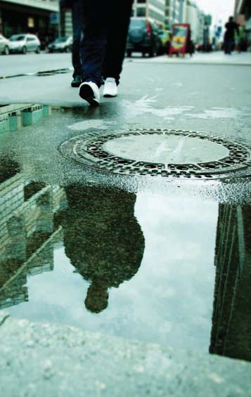
A BLUE CITY HAS A ROBUST REGULATORY FRAMEWORK
  Its leaders work with senior governments to establish sectoral water conservation requirements, standardize greywater use and enhance non-point source pollution management
  It develops formal policies such as developing topsoil bylaws and requirements for appliance-labelling
  Its provincial counterparts do their part to enhance governance processes and facilitate information exchange
  Its councillors direct and support staff to design programs, incentives and pilots to reach water management targets and respond to immediate needs

Slide 10



A BLUE CITY RELIES ON PERFORMANCE-BASED REGULATIONS
Its elected officials work closely with their provincial counterparts to transition regulations and building codes away from being practice-based and prescriptive, towards defining performance requirements
  It creates opportunity for implementing innovative processes and techniques, provided they meet the defined outcomes
It reduces the phenomenon of one-off pilot projects that require regulatory exceptions – projects that can never be replicated because of onerous bureaucratic processes
Incentivise utilities using performance-based regulations. Coupled with other incentives, regulation can help the industry in the long run by setting water efficiency benchmarks and standards.”
– Glen T. Daigger,
Sr. President & CTO, CH2M HILL.

Slide 11


A BLUE CITY GOVERNS ITS
UTILITIES EFFECTIVELY
  The utility’s performance and financial practices are regulated by an independent agency, to ensure accountability and transparency
  It measures the performance of utilities to facilitate transparent reporting and to inform the planning processes
Information flows from the bottom up. Direction flows from the top down. You need alignment. If you don't set up systems to be able to feed information in a meaningful way that aligns with outcomes, you won't be able to make good decisions.”
– Greg P. Chartier,
Asset Management Consultant, Independent

Slide 12





A BLUE CITY PROVIDES PERSONALIZED INFORMATION ON WATER USAGE
  It provides customers with personalized feedback on their water use and behaviours (similar to internet providers)
=
+
+
+
WATER BILL
One trend that's been overlooked is 'The Amazon Effect'. People are starting to ask, 'why can't I see my water bill and see how much water I'm using.' When you put that data in the consumer's hands, the game changes.”
– David Henderson,
Founder & Managing Director, XPV Capital Corporation

Slide 13



A BLUE CITY USES CUTTING-EDGE TECHNOLOGY
  It formulates new utility configurations around innovative service models for drinking water, wastewater and stormwater
  It incorporates technology that makes source separation economically viable
  Its infrastructure maintains the natural environment and minimizes the impact of activities on native ecosystems

Slide 14

A BLUE CITY MAKES A CLEAR BUSINESS CASE FOR BEING BLUE
  It frames its business case around its
  pain points
  It clearly identifies the value created for customers by being a blue city
  It includes long-term financial models, which are necessary for sustainable solutions
  It makes choices based on what’s economically and environmentally logical, but also considers public opinion and political preference
It all comes down to money. You need to show you're saving people money. Life cycle costing and analysis should be required of all new developers. You need to figure out the financial benefits. And you need to be rewarded for making this step, not penalized. It has to be a good news story for the client too.”
– Mary Ann Dickenson,
President & CEO, Alliance for Water Efficiency

Slide 15



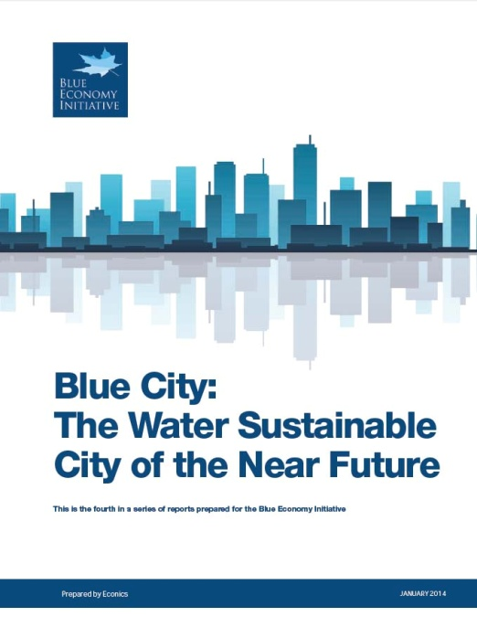







SHARE OUR VISION? READ MORE
Follow BEI on Twitter @ BlueEconomyca

